Slide 1
Communicating Data During COVID 19 GIS & Data Visualization Working Group Webinar 1
Wednesday, March 31, 2021
2:00 PM ET

Slide 2
Housekeeping
A few notes:
Your mic will be kept muted during the duration of this webinar to cut down on background noise
Feel free to submit questions in the question box; we will hold Q&A after all presenters have spoken
This webinar will be recorded and posted to the working group webpage after the meeting

Slide 3
Today’s Agenda
Welcome
Caitlin Cook, AMPO
2. Introductions
Mara Kaminowitz, Baltimore Metroplan Council
3. Virtual Public Engagement
Lisa Houde, DRCOG
4. Broward MPO Data Visualization Tools
Paul Flavien, Broward MPO
5. NCTCOG’s Map Your Experience Public Comment Tool
James McLane, NCTCOG
6. Q&A
Today’s Moderator
Mara Kaminowitz
Baltimore Metroplan Council Leadership

Slide 4
Meet the Speaker Lisa Houde, DRCOG
Lisa Houde, AICP, is a public engagement specialist at the Denver Regional Council of Governments where she plans and implements outreach strategies for DRCOG’s many work functions, including its role as the Metropolitan Planning Organization. She also manages the Citizens' Academy, a civic engagement capacity-building program for residents. She previously worked as a Senior City Planner for the City of Minneapolis and as an Associate at Clarion Associates. She has a Master of Urban & Regional Planning degree from the University of Colorado Denver.

Slide 5
Virtual Public engagement
AMPO GIS & Data Visualization Working Group
March 31, 2021
Lisa Houde, Public Engagement Specialist

Slide 6
Engagement in the time of Covid
Shift to ALL virtual
Lessons learned from pre-Covid virtual engagement
Interactive maps
Virtual open house

Slide 7
Vision Zero
Complete Streets
2050 RTP

Slide 8
Vision Zero

Slide 9
Regional Vision Zero (2019)
Paid social media promotion
Over 3,200 completed surveys
Nearly 1,100 comments submitted on web map

Slide 10
Notes:
Crowdsource reporter

Slide 11
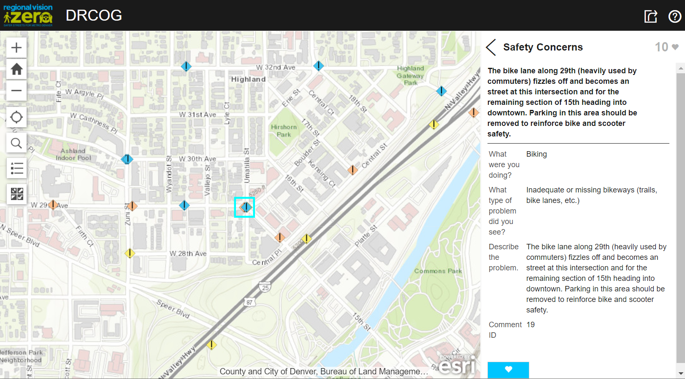
Notes:
Crowdsource reporter

Slide 12
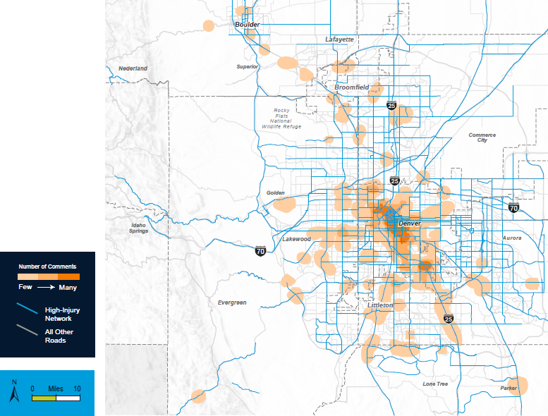

Slide 13
COMPLETE STREETS

Slide 14
Regional Complete Streets Toolkit
Comment map and questionnaire – Social Pinpoint
Meaningful opportunities for input
Answer the question: What makes a Complete Street?
Willingness to make tradeoffs
Input will inform toolkit development

Slide 15
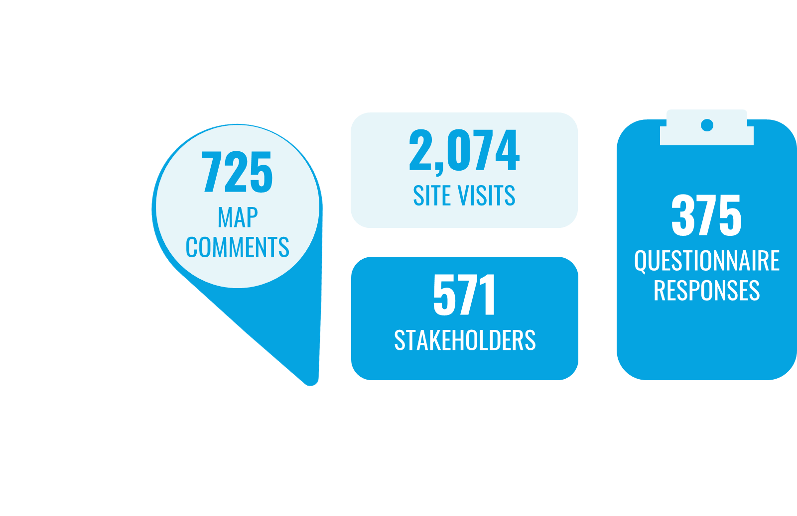
Engagement Results

Slide 17
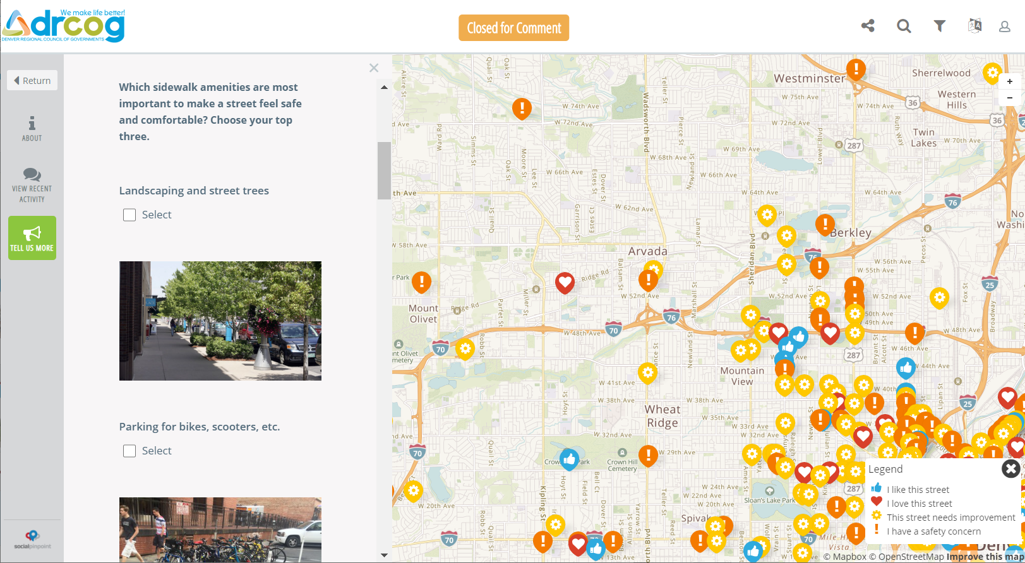

Slide 18
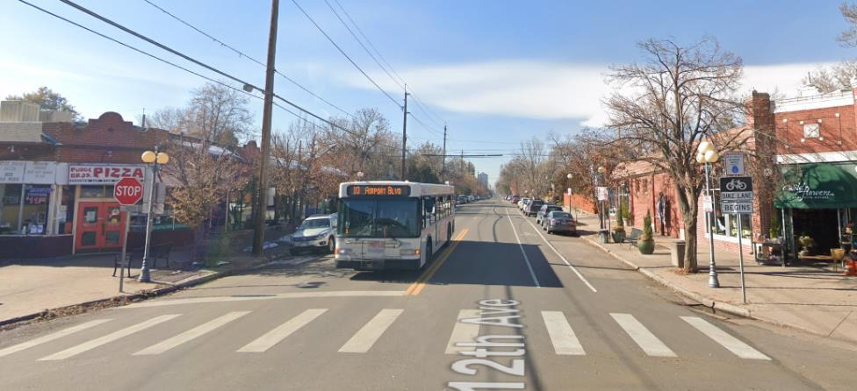
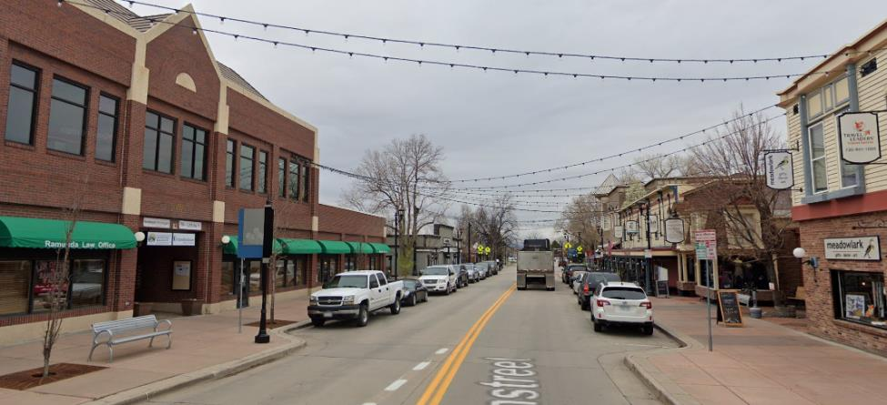
Example Complete Streets comments
12th Avenue, Denver
Mainstreet, Parker
“12th Avenue (esp. at Madison St.) is perfectly scaled for walking, biking, driving, and the RTD route that services 12th. No matter which of the above forms of transportation I take along 12th it feels safe and efficient.”
“Businesses close to the street, Plenty of sidewalk to walk, slower traffic speeds, trees”

Slide 19
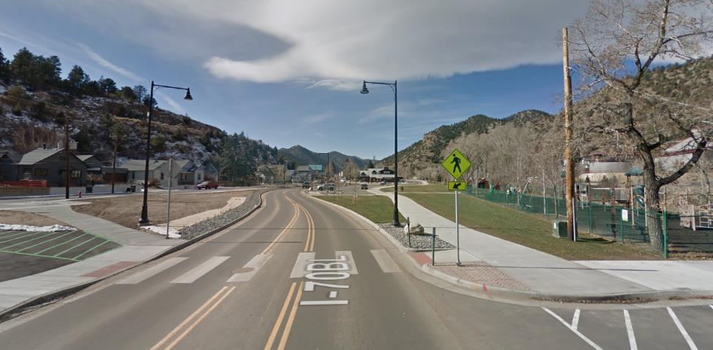
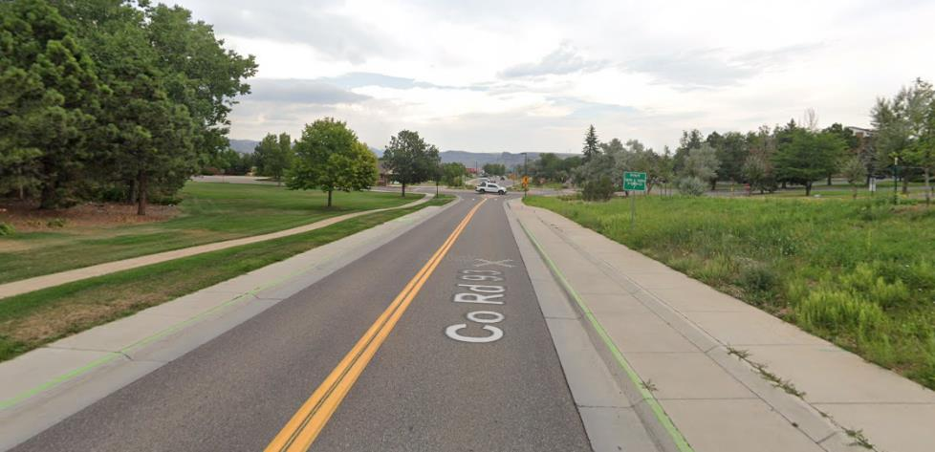
Example Complete Streets comments
Colorado Blvd, Idaho Springs
Heritage Road, Golden
“Great big sidewalk, access to open park area.”
“good pedestrian comfort, also roundabouts slow traffic. raised bike lanes help riders not comfortable in an on street bike lane.”

Slide 20
2050 REGIONAL TRANSPORTATION PLAN

Slide 21
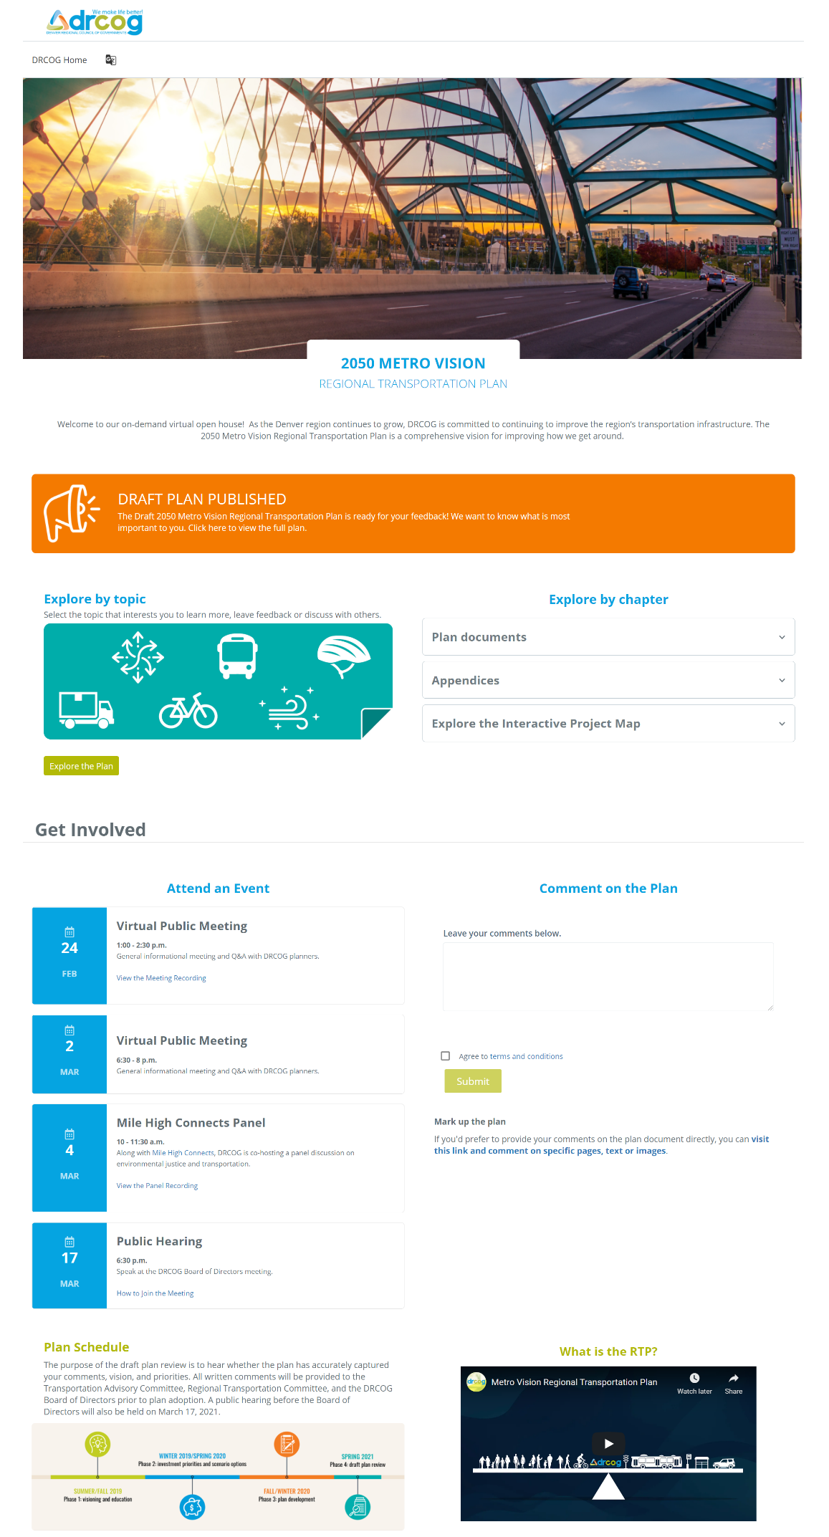
Opportunities for input
Virtual on-demand open house
Plan documents and summaries
Surveys and discussion boards
Interactive map to explore projects in detail
Virtual public meetings
Regional presentations
Public hearing
Notes:
LISA

Slide 22
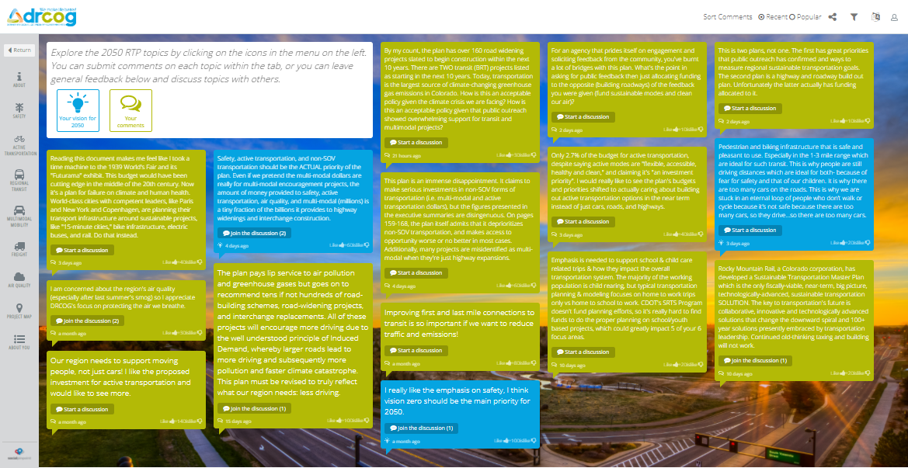

Slide 23
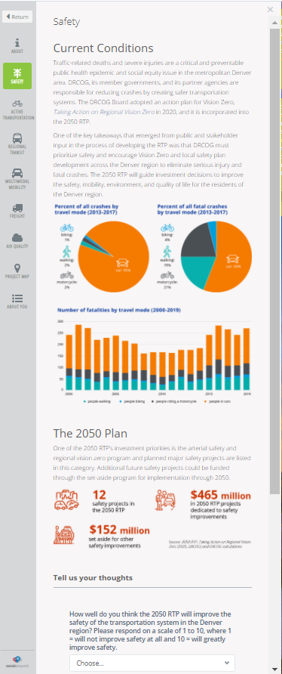

Slide 24
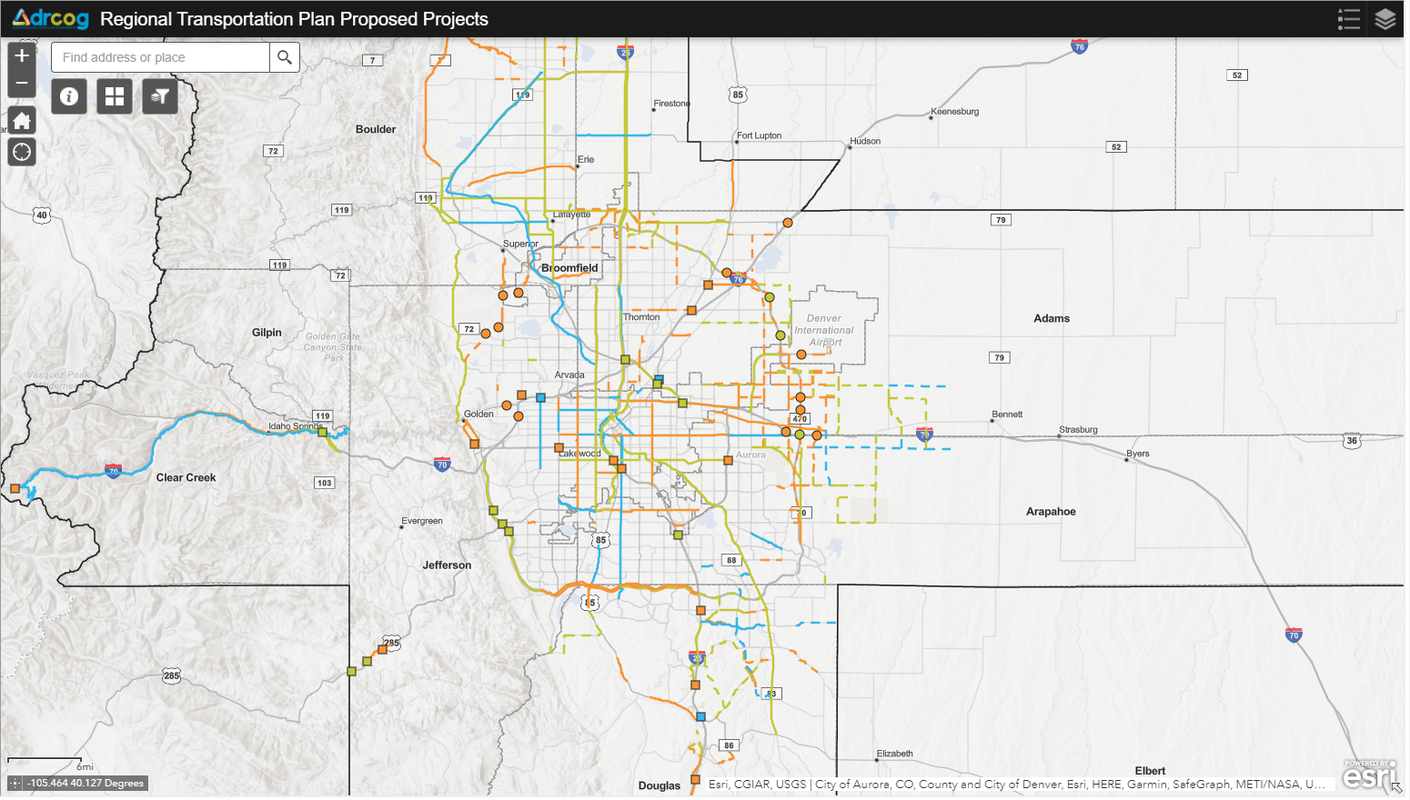
Interactive project map

Slide 25
Input received
200+ written comments
250 interactive poll responses in meetings
6 people testified at public hearing
Over 4,000 visits to open house from 1,392 users
90 attendees at public meetings

Slide 26
Takeaways: Virtual Engagement at DRCOG
Comment maps most successful tool
Generally more involvement than in-person efforts
Need to study demographics better
Prep for time consuming comment analysis

Slide 27
QUESTIONS?
THANK YOU!
Lisa Houde, AICP
lhoude@drcog.org

Slide 28
Meet the Speaker Paul Flavien, Broward MPO
Paul Flavien is the Data Services Manager for the Broward MPO. He has been with MPO for 10 years. His responsibilities include Travel Demand modeling, Freight planning, Performance Measures and socio-economic data development. Prior to joining the MPO, Paul worked in the private sector for eight years as a transportation planner.

Slide 29
Broward MPO Data Visualization Tools
March 31, 2021 AMPO GIS & DATA Visualization Working Group
Paul Flavien, Data Services Manager

Slide 30
Broward MPO Data Visualization Tools
Performance Measures Dashboard
The dashboard helps the MPO to share complex data related to federal performance measures with stakeholders and public in an easily understandable and visually pleasing manner
Version 1 of the dashboard was created in 2018
This is the 3rd version of the dashboard

Slide 31
Performance Measures Dashboard Demonstration

Slide 32
Broward MPO Data Visualization Tools
Municipal Profiles
The MPO developed profiles for the 31 municipalities in Broward
Intent is to provide our municipal partners with easily accessible population, transportation and economic statistics about their cities
Profiles are updated yearly as the ACS is updated

Slide 33
Municipal Profiles Demonstration

Slide 34
Contact Information
Paul Flavien
Data Services Manager
(954) 876-0045
flavienp@browardmpo.org

Slide 35
Meet the Speaker James McLane, NCTCOG
In his role as an information analyst at the North Central Texas Council of Governments, James is an advocate for data-driven and performance-based regional transportation planning. His main areas of focus include GIS coordination, data management, performance measurement coordination, and data analysis to support NCTCOG's mission. He has a B.S. in Geography from the University of Oklahoma.

Slide 36
NCTCOG’s Map your experience public comment tool
Amy Johnson, Carli Baylor, James McLane
AMPO GIS & Data Visualization Working Group Webinar
March 31, 2021

Slide 37
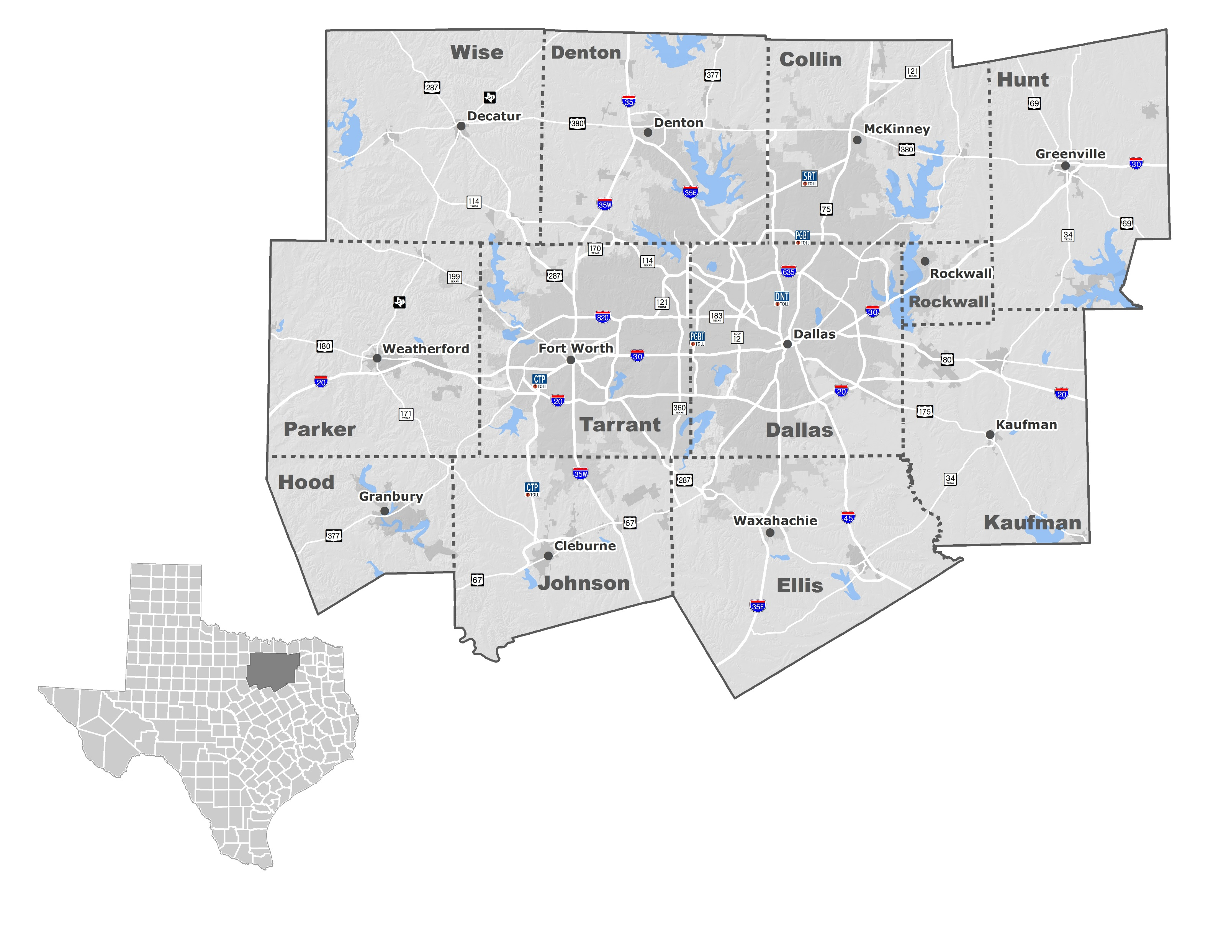
background
Large, diverse planning area
12 counties, >7 million population
Demand for new, engaging public involvement tools before and during pandemic
Desire to incorporate public feedback into data-driven planning initiatives

Slide 38
Basic Functionality
Online mapping tool to gather public comments
Users click on a point and describe an issue they experience as users of the region’s transportation system at that location
Focus on specific issues, not projects
Desire to quantify needs holistically
Designed to provide input to multiple planning initiatives

Slide 39
Basic Functionality

Slide 40
Categories
Roadway
Traffic
Signal Timing
Parking
Freight/Delivery
Road Condition
Safety
Noise Pollution
Air Pollution
Other
Transit
Stops/Stations
Shelters
Connections
Service Frequency
Travel Time
Facility Condition
Safety
Lighting
Other
Bicycle/Pedestrian
Lanes, Stripes, Markings
Sidewalk/Trail Availability
Sidewalk/Trail Condition
Traffic Signals
Crosswalks
Safety
Lighting
Other
Notes:
Will not be discussing all categories here. Primarily provided to illustrate extent of categories.

Slide 41
Platform
ESRI ArcGIS Online Crowdsource Reporter application template
Easy and relatively quick to launch and maintain
Comment points accessible in ArcGIS Online and desktop ArcGIS
Automation possible to feed comments into existing processes

Slide 42
Launch
Initially created to engage the public at in-person community events
Became important online strategy as in-person events were cancelled
Beta tested from March to August 2020
Publicized through public involvement channels:
Department’s monthly online input opportunities
Social media (Facebook & Twitter accounts)
Newsletter articles
Press release
Notes:
Verbally note how beta testing went (engagement, lessons learned, tweaks)

Slide 43
Overcoming Potential Issues
Additional exposure will move comments closer to being a representative sample
Upcoming Mobility Plan campaign seeking diverse participation with focus on EJ groups
Tools like this have proven to be popular engagement strategies during the pandemic
Looking for future opportunities and in-person variations while avoiding duplication

Slide 44
Applying Received Comments
Holistically evaluating policy, program, and project recommendations in our plans
Are draft recommendations meeting needs?
If not, how (and where) can they be adjusted?
Do we need additional programs to address recurring issues?
Sharing comments with other local entities and stakeholders

Slide 45
Recent developments and next steps
Continuous processing of incoming comments through existing public comment framework
Spanish translation
Dashboards and other summary tools
Tweaks and adjustments to interface as needed
Additional promotion of tool through Mobility 2045 Update public involvement processes
Notes:
Will note here that this is a tool that has generated considerable interest within the agency and a number of potential offshoot applications are under development.

Slide 46
Contact Us
www.nctcog.org/MapYourExperience
transinfo@nctcog.org
Amy Johnson
Transportation Planner III
ajohnson@nctcog.org
(817) 704-5608
Carli Baylor
Communications Specialist II
cbaylor@nctcog.org
(817) 608-2365
James McLane
Senior Information Analyst
jmclane@nctcog.org
(817) 704-5636
46

Slide 47
User experience
(Time and Curiosity Permitting)
Notes:
Provided in case there’s interest in a walkthrough of the tool.

Slide 48
User experience
Orientation page

Slide 49
User experience
Orientation page
Application home

Slide 50
User experience
Orientation page
Application home
Select Category

Slide 51
User experience
Orientation page
Application home
Select Category
Click “Submit Comment”

Slide 52
User experience
Orientation page
Application home
Select Category
Click “Submit Comment”
Click point on map

Slide 53
User experience
Orientation page
Application home
Select Category
Click “Submit Comment”
Click point on map
Fill out form and click “Report It”

Slide 54
Questions & Answers
Please submit your questions via the question box
Lisa Houde: LHoude@drcog.org
Paul Flavien: flavienp@browardmpo.org
James McLane: JMcLane@nctcog.org

Slide 55
Thank you for joining us!
It’s not too late to sign up for the GIS & Data Visualization Working Group! Visit https://ampo.org/working-groups/working-group-application to join today!

