Slide 1

[YOUR MPO LOGO]
ASSOCIATION OF METROPOLITAN
PLANNING ORGANIZATIONS
BUILD America 250 Act
[REGION] Briefing
What Regions and Locals Need to Know
[DATE] | [MPO NAME] Board of Directors
AMPO.ORG
Notes:
KEY TAKEAWAYS FOR YOUR BOARD — Cover Slide
• Open by welcoming board members and framing this as a practical board briefing, not a full legislative deep dive.
Clarify up front that this deck summarizes the House Transportation & Infrastructure Committee bill — the BUILD America 250 Act, or BA250. The Senate has not released its companion text yet, so this is a moving process.
Optional opening line: “The goal today is to explain what is in the House bill, what it could mean for our region, and what we should be watching as Congress continues negotiations.”
NOTE: replace [REGION], [DATE], and [MPO NAME] before presenting

Slide 2

TODAY'S BRIEFING
Agenda
1
Reauthorization 101
2
What is the BUILD America 250 Act?
3
Where We Are in the Process
4
Key Provisions for Our Region
5
Potential Funding Opportunities for [MPO Name]
6
What to Watch & Next Steps
AMPO.ORG
Notes:
KEY TAKEAWAYS FOR YOUR BOARD — Agenda
Keep this slide brief. Let the board know the presentation is designed for a 15–20 minute discussion with time for questions.
Emphasize that the deck focuses on regional and local implications — not every provision in a 1,000+ page bill.
Mention that AMPO has more detailed written resources for folks who want to dig deeper after the meeting.
Presenter tip: If your board has a strong interest in transit, bridges, safety, freight, active transportation, rail, etc. note that AMPO can provide additional issue-specific materials.

Slide 3
Reauthorization 101: What Is It & Why Does It Matter?
01
What Is Reauthorization?
02
When Does It Happen?
03
Who Writes the Bill?
Congress periodically passes a multi-year law that authorizes federal surface transportation programs and sets funding levels and policy provisions for highways, transit, bridges, safety, and planning.
Roughly every 5 years — though delays and extensions are common.
Past bills: SAFETEA-LU (2005), MAP-21 (2012), FAST Act (2015), IIJA/BIL (2021). Each bill shapes how federal transportation dollars flow for the following half-decade.
Multiple House and Senate committees with jurisdiction over highways, transit, rail, safety, and finance.
The House T&I Committee leads on highway and transit policy. Revenue/tax provisions go through Ways & Means (House) and Finance (Senate).
SURFACE TRANSPORTATION BILLS — A RECENT HISTORY
TEA-21
SAFETEA-LU
MAP-21
FAST Act
IIJA / BIL
Next Bill
1998
2005
2012
2015
2021
TBD
WHY IT MATTERS
Reauthorization determines how much federal money flows to our region, which programs we can access, what we can spend it on, and how much flexibility we have in project selection. For [MPO Name], this bill will govern federal transportation investment for the next five years — roughly $[X]M annually in formula funds alone under the current bill (the IIJA).
AMPO.ORG
Notes:
KEY TAKEAWAYS FOR YOUR BOARD — Reauthorization 101
Start with the basic definition: surface transportation reauthorization is the multi-year federal law that authorizes highway, transit, bridge, safety, freight, and planning programs.
The important point for board members is that reauthorization is not abstract federal policy. It determines how much funding flows to regions, which programs local governments can access, what activities are eligible, and how much flexibility MPOs and local partners have.
Use the timeline to show that Congress revisits these bills roughly every five years, but extensions are common when negotiations run past the deadline and when there is a lot of work on their plate.
Connect this directly to your region: “For [MPO Name], this bill will shape our planning funds, STBG and TAP suballocations, eligibility for safety and bridge programs, and the federal rules attached to the projects in our TIP.”
NOTE: Before presenting, fill in the annual formula funding estimate in the callout box.

Slide 4

SECTION 01 — BACKGROUND
What Is the
BUILD America
250 Act?
“Building Unrivaled Infrastructure and Long-term Development for America's 250th Act”
The House version of the next surface transportation reauthorization
AMPO.ORG
Notes:
KEY TAKEAWAYS FOR YOUR BOARD — Section Divider: What Is BA250?
Use this as a short transition slide.
Suggested transition: “With that context, let’s turn to the House bill itself — what BA250 is, how large it is, and how it differs from the IIJA.”
NOTE: Do not spend much time here. The next slide carries the substance.

Slide 5



What Is the BUILD America 250 Act?
IIJA Expires Sept. 30, 2026
$580.9 B Over 5 Years
Major Structural Shift
Congress must pass a new surface transportation bill or an extension.
BA250 is the House T&I Committee's proposed reauthorization for next surface bill.
Note: previous bill was the Infrastructure Investment and Jobs Act (IIJA).
BA250 authorizes $580.9B for FY2027–2031.
This is a 4% overall increase from the IIJA.
Highway Trust Fund covers ~$474B ; General Fund covers ~$107B.
90% of authorized funding is in formula programs. Different approach from IIJA, which had many competitive programs.
Local and regional entities are positioned to receive ~22% of total federal transportation funding.
AMPO.ORG
Notes:
KEY TAKEAWAYS FOR YOUR BOARD — What Is the BUILD America 250 Act?
BA250 is the House Transportation & Infrastructure Committee’s five-year surface transportation reauthorization proposal for FY2027–FY2031.
The bill authorizes about $580.9 billion over five years, including roughly $474 billion from the Highway Trust Fund and roughly $107 billion from the General Fund (which is subject to appropriations).
The biggest structural change from the IIJA is the shift back toward formula funding. BA250 places about 90 percent of authorized funding in formula programs, which generally means more predictable annual funding compared with competitive grant programs.
For MPOs and local governments, the headline is that local and regional entities are positioned to access roughly 22 percent of total federal transportation (a win!) funding through planning funds, STBG, TAP, SS4A, STAG, bridge programs, CMAQ, and other eligible opportunities.
NOTE: Be careful to frame this as the House bill only. The Senate has not yet released text, and the final enacted bill is likely to change many provisions.

Slide 6


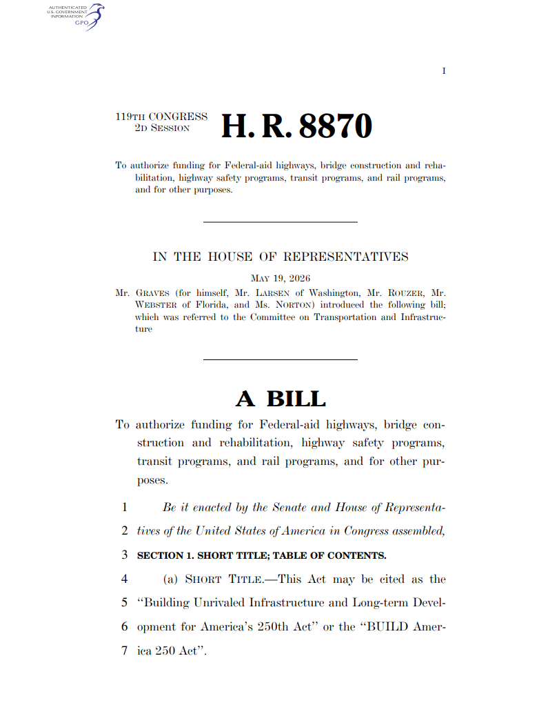

Where We Are: Legislative Timeline
Congress is working on the next surface transportation reauthorization. IIJA was the last surface bill — expires Sept. 30, 2026.
Ways & Means
In progress (revenue)
1
2
3
4
5
May 17, 2026
House Base Text Released
BUILD America 250 Act
May 21, 2026
House T&I Committee Markup (H.R. 8870)
Future
Potential House Passage
Potentially late June
The Senate
No companion text released
Extension
Highly likely outcome due Congressional calendar
EPW
Commerce
Banking
Senate Committees — no bill yet
Notes:
KEY TAKEAWAYS FOR YOUR BOARD — Legislative Timeline
The House process is underway. The House Transportation & Infrastructure Committee released BA250 in May and advanced it from committee after markup by a bipartisan 62–2 vote.
The bill still has several steps before becoming law: House floor action, Senate committee work, bicameral negotiations, and revenue/financing decisions.
The Senate remains the major unknown. EPW, Commerce, and Banking have not yet released companion surface transportation text, and the Senate bill may differ significantly from the House version.
A short-term extension is a realistic near-term outcome if Congress does not finish a final bill before September 30, 2026.
Extensions generally keep formula programs moving, but they can create uncertainty for discretionary programs, especially those that relied on IIJA advance appropriations (Division J).
Suggested board message: “This is an important first marker, not the final law. Our job is to understand what is in the House bill, educate on regional priorities, and stay engaged as the Senate and House negotiate.”

Slide 7

SECTION 02 — KEY PROVISIONS
What BA250
Means for
Our Region
Highway Programs
Key provisions with direct local and regional impact
AMPO.ORG
Notes:
KEY TAKEAWAYS FOR YOUR BOARD — Section Divider: Key Provisions
Use this slide to signal the board is entering the most locally relevant part of the briefing.
Suggested transition: “The next few slides are the core of the bill — what BA250 could mean for our region’s planning capacity, local project funding, bridge needs, and future funding opportunities.”

Slide 8
Five-Year Funding Overview — $580,972,000,000
$293.9B
$56.0B
$35.0B
$9.3B
Federal-Aid Highway
Program
Bridge Program
(Formula + Competition)
Discretionary
Grant Programs (Highway)
Federal Lands
& Tribal Programs
Core formula programs
New bridge investment
INFRA, SS4A, PROTECT, etc.
NPS, FLTP, Tribal, etc.
5-year totals: Highway Trust Fund Authorization: ~$474B ; General Fund Authorization: ~$107B
Notes:
KEY TAKEAWAYS FOR YOUR BOARD — Five-Year Funding Overview
Use this slide to show the scale of the bill without getting lost in program-level detail
The Federal-Aid Highway Program remains one of the most important piece of the bill for our purposes and is the main source for core formula programs used by states, MPOs, and local governments.
Bridge funding is a major emphasis, including both formula and competitive components. This is important for regions with local bridge needs that may not rise to the top of statewide priority lists.
Certain Discretionary highway grant programs remain and new programs are created, but the overall bill shifts more heavily toward formula funding than the IIJA.
The annual authorization chart shows steady growth from FY2027 through FY2031. The message for the board is predictability: a multi-year bill gives regions more confidence to plan, program, and deliver projects.
NOTE: If your board asks whether these are guaranteed dollars, distinguish between Highway Trust Fund contract authority and General Fund authorizations that still depend on appropriations.

Slide 9




Big Picture: Highway Funds
Paradigm Shift
Local & Regional Share
90% of funding in formula programs
~22% of total federal transportation funding
Moves away from competitive grants toward stable formula funding — more predictable for regional planning and programming.
Local and regional entities access funding through PL, STBG, TAP, SS4A, STAG, Bridge Formula, and CMAQ programs.
MPO Planning (PL) Wins
Watch List
#1 largest % increase of any formula program
⚠ Items to monitor closely
PL grows 9.7% in FY27 (+$45.8M). New Direct Recipient option, FMIS access, expanded eligibilities, and local match requirement reduced to 10%.
Consolidated Funding Pilot Program gives states a block grant — MPOs must be consulted. CRP eliminated; CMAQ has new alt-fuel set-aside.
AMPO.ORG
Notes:
KEY TAKEAWAYS FOR YOUR BOARD — Big Picture: Highway Funds
Paradigm shift: BA250 moves more funding through formula programs. For regions, formula funding is valuable because it is more predictable, arrives annually, and can be programmed through regional planning processes.
Local and regional share: The roughly 22 percent local/regional access number is a central board takeaway. It reflects access through formula suballocations, competitive programs, local bridge funding, planning funds, and eligible applicant roles.
MPO planning wins: PL funds receive one of the strongest percentage increases among formula programs. BA250 also makes several improvements to the PL program (covered on following slide)
Watch list: The consolidated funding pilot, CRP elimination, and CMAQ alternative-fuel set-aside all deserve close monitoring because they could affect how flexible dollars are distributed and programmed within states (covered on future slide).
Suggested board message: “Overall, the bill contains meaningful many MPO and local wins, but the implementation details matter.”

Slide 10

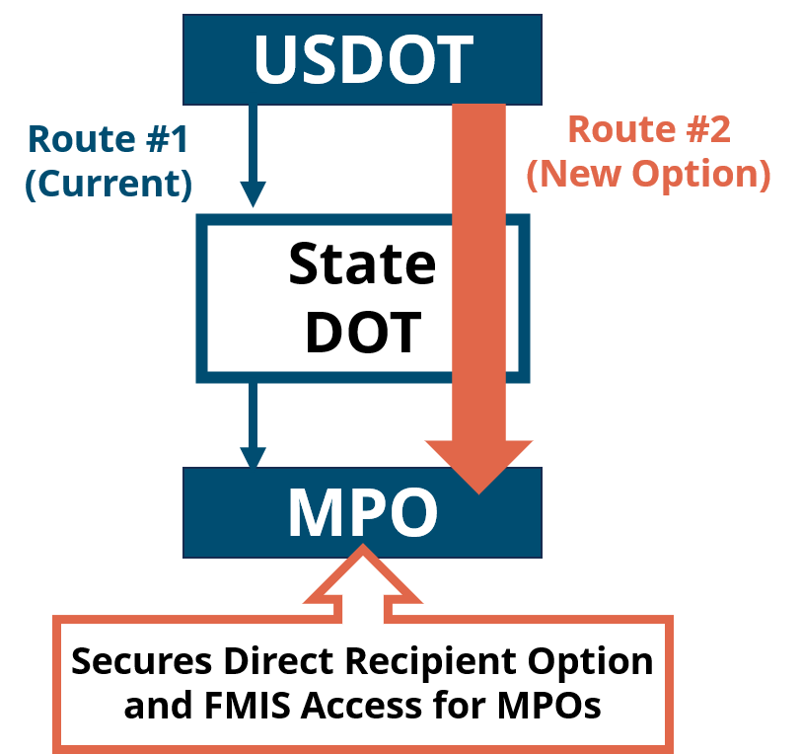
Metropolitan Planning Program (PL Funds)
22.8% Increase
over 5 years
Federal Share: 90/10
Expanded Eligibilities
  Fiscal administration of local projects
  Preliminary design
  Local technical assistance
  Studies linked to transportation
  Data procurement
Direct Recipient Option
  FMIS access for direct recipients
PL FUNDS
FY 2027 | $520 M
FY 2028 | $540 M
FY 2029 | $560 M
FY 2030 | $580 M
FY 2031 | $600 M
Grows 9.66% FY26 to FY27 (+$45.8 million)
PL is the largest % increase of any core formula program in BA250
Notes:
KEY TAKEAWAYS FOR YOUR BOARD — Metropolitan Planning Program (PL Funds)
Funding growth: National PL funding increases from $520 million in FY2027 to $600 million in FY2031. The program grows 9.66 percent from FY2026 to FY2027 and 22.8 percent from FY2027 to FY2031.
Federal share: BA250 changes the standard PL federal share to 90 percent, reducing the local match to 10 percent. This can free up local dollars.
Expanded eligibilities: The bill adds activities that can better connect planning to delivery, including fiscal administration of local projects, preliminary design, local technical assistance, transportation-related studies, and data procurement.
Direct recipient option: MPOs could choose to pursue direct recipient status rather than receive PL funds through the state DOT pass-through process, if they have the capacity and interest to do so.
FMIS access: Direct-recipient MPOs would receive access to FMIS, improving visibility into federal funding obligations.
Suggested board message: “This is not only a funding increase. It also gives MPOs more tools to support local project delivery and, where appropriate, more control over how planning funds are administered.”

Slide 11
Funds for Regional & Local Delivery
Bridge Formula Program
~$9B / yr
Safe Streets and Roads for All
~$500M FY27
Surface Transportation Accelerator Grant (STAG)
~$2.4B / yr
20% off-system set-aside plus a 25% competitive carve-out for locally-owned bridges — 95% federal match for local/tribal owners.
MPO consultation role on off-system bridges
TMA MPOs are eligible applicants for competitive bridge program
~$3.75B over five years for local safety projects. 90% federal match; planning grants capped at 5% of total funds. MPOs eligible.
FY 28 — $625 M
FY 29 — $750 M
FY 30 — $875 M
FY 31 — $1.0 B
Large, new, flexible program with wide eligibility (similar to BUILD/RAISE):
Local & regional grants: 50% of funding
Rural grants: 25% ($600 M)
Urban grants: 25% ($600 M)
Notes:
KEY TAKEAWAYS FOR YOUR BOARD — Funds for Regional & Local Delivery
Use this slide to explain the programs that could most directly support local and regional project delivery.
Bridge Formula Program: BA250 maintains a 20 percent off-system bridge set-aside and creates a 25 percent competitive carve-out for locally owned bridges, with a 95 percent federal match for local and tribal owners. MPOs have a consultation role for off-system bridges, and TMA MPOs may apply for the competitive bridge program.
Safe Streets and Roads for All: SS4A continues as a Highway Trust Fund competitive program. Funding starts at $500 million in FY2027 and increases to $1 billion in FY2031. MPOs and local governments remain eligible for planning and implementation activities.
Planning grants are capped at 5 percent of the program total.
Surface Transportation Accelerator Grant: STAG is a new flexible competitive program with broad eligibility. The House bill reserves a significant share for local applicants, it also includes rural and urban categories.

Slide 12
Potential Funding Opportunities for [Region Name]
22.8%
$[X]M
$9B
~22%
PL Funds increase
FY27→FY31
Estimated PL
allocation FY27
Bridge funds
per year nationally
Local share of
total fed. $ available
Program
FY27 National $
MPO Role
Est. for [MPO]
Planning (PL) Funds
$520M
Suballocation or Direct Recipient
$[X]M
Surface Transportation Block Grant (STBG)
$16.1B
Suballocation
$[X]M
Transportation Alternatives (TAP)
$1.6B
Suballocation
$[X]M
Safe Streets for All (SS4A)
$500M
Applicant
-
Bridge Formula — Local Set-Aside
$2.25B
In-state competition
$[X]M
Surface Transportation Accelerator (STAG)
$2.4B
Potential Applicant
-
AMPO.ORG
Notes:
KEY TAKEAWAYS FOR YOUR BOARD — Funding Opportunities for [MPO Name]
Fill in each $[X]M placeholder before presenting OR DELETE THE “Est. For [MPO] column”
Planning (PL): These are the MPO’s core operating and planning funds. BA250 increases national PL funding, reduces the local match to 10 percent, expands eligible activities, and creates a potential direct recipient option.
STBG and TAP: These remain the key flexible suballocated programs for regional and local projects.
SS4A: This program continues under BA250 as a highway trust fund competitive program, and MPOs and local governments remain eligible applicants for planning and implementation activities. This matters for regional safety action plans and local project delivery.
STAG: This is a new flexible competitive program under the highway trust fund in the House bill, with a significant local/regional eligibility component.
Bridge Formula local set-aside: This is a major local bridge opportunity and a historic amount of funding

Slide 13
What to Watch & Next Steps
⚠ WATCH CLOSELY
✓ AMPO’s RECOMMENDED ACTIONS
Consolidated Funding Pilot
1
Educate your Congressional Delegation
Up to 10 states receive a lump-sum block grant. MPOs must be consulted on local fund distribution — but consultation ≠ veto.
Educate your delegation on BA250 wins including, planning fund improvements, local match reductions, local safety and bridge funding, increased flexible STBG funding.
CRP Eliminated
Carbon Reduction Program ends FY27. Most projects remain eligible under STBG and CMAQ.
2
Build on the Base
The reauthorization process is a long timeline. Continue educating your Delegation on the importance of meaningful support for regions/locals. Flag any concerning elements.
CMAQ Alt-Fuel Set-Aside
10% of CMAQ must fund alternative fueling in FY27, declining to 7% by FY30. Could reduce dollars available for regional priorities.
Follow the Process
3
AMPO has lots of resources surrounding national and federal updates on the federal surface transportation reauthorization process. Follow our newsletter and reach out with questions
RTPO Funding Not Included in BA250
The Local Officials in Transportation (LOT) Coalition’s BASICS Act (H.R. 7437) RTPO proposal ($150M/yr, 100% federal) was not included in BA250. The LOT Coalition continues to support its addition in the Senate.
4
Work with your National Organizations
3
AMPO as well as the LOT coalition (NLC, NACo, USCM, NADO, NARC, and NADO) have resources to help support local and regional engagement in the reauthorization process.
AMPO.ORG
Notes:
KEY TAKEAWAYS FOR YOUR BOARD — What to Watch & Next Steps
Watch List:
Consolidated Funding Pilot: Explain that this would allow up to 10 states to receive highway funds as a consolidated block grant. MPO consultation is included, but uncertainty remains on how funds would be split up within states for suballocated programs.
CRP elimination: BA250 would eliminate the Carbon Reduction Program starting in FY2027. Many CRP-eligible activities would remain eligible under STBG, CMAQ, and other flexible funding sources, but regions that rely on CRP should track how those projects would be reprogrammed if this bill were to pass as is.
CMAQ alternative-fuel set-aside: The proposed set-aside could reduce the amount of CMAQ available for other regional air-quality priorities, especially in nonattainment or maintenance areas.
RTPO funding: The LOT Coalition’s BASICS Act (H.R.7437) RTPO proposal was not included in the House bill. AMPO and LOT coalition partners continue to support dedicated rural planning capacity in the Senate process.
AMPO’s Recommended actions:
Educate congressional offices on concrete regional examples — planning capacity, bridge needs, safety projects, and local project delivery. How the proposed bill would uplift/support regional priorities, flag any provisions that could pose challenges for the region, and note areas where priorities can be built upon.
Follow along with our resources (see final slide with links with more information)
Suggested close: “This bill is a strong starting point in several areas, but it is not the final word. We should continue to share what is working, what needs improvement, and how federal decisions affect project delivery in our region.”

Slide 14

Questions &
Discussion
Contact
AMPO Resources
[MPO Director Name]
AMPO BA250 Legislative Guide
  AMPO Amendment Tracker
AMPO Summary Slide Deck
AMPO BA250 Summary Handouts
AMPO BA250 Letter of Support
National Beat Federal Policy Newsletter
  Past Editions of the National Beat
[Title]
[MPO Name]
[email@mpo.org]
[Phone]
AMPO Contact: Katie Economou, Legislative Director keconomou@ampo.org
AMPO.ORG
Notes:
KEY TAKEAWAYS FOR YOUR BOARD — Questions & Discussion
Invite questions and be clear that some answers may depend on future Senate text or implementation details.
Direct board members and staff to the AMPO resources listed on the slide for deeper analysis, legislative text summaries, digestible summaries, and future updates.
Suggested closing line: “AMPO will continue tracking the House bill, Senate activity, potential extensions, and any changes that affect MPOs and local project sponsors. We will keep the board updated as the process moves.”
NOTE: If a question is highly region-specific, offer to follow up with AMPO and we can get you back a response

Slide 15
APPENDIX — MORE INFORMATION
APPENDIX
Authorization Levels and Deep Dive
AMPO.ORG
Notes:
APPENDIX SECTION
Feel free to use the follow slides for more of a deep dive into the bill – remember to “unhide” the slides before use.

Slide 16
OVERVIEW OF BA250
Local & Regional Outlook
Key Provisions
AMPO.ORG
Notes:
APPENDIX SECTION
Feel free to use the follow slides for more of a deep dive into the bill – remember to “unhide” the slides before use.

Slide 17
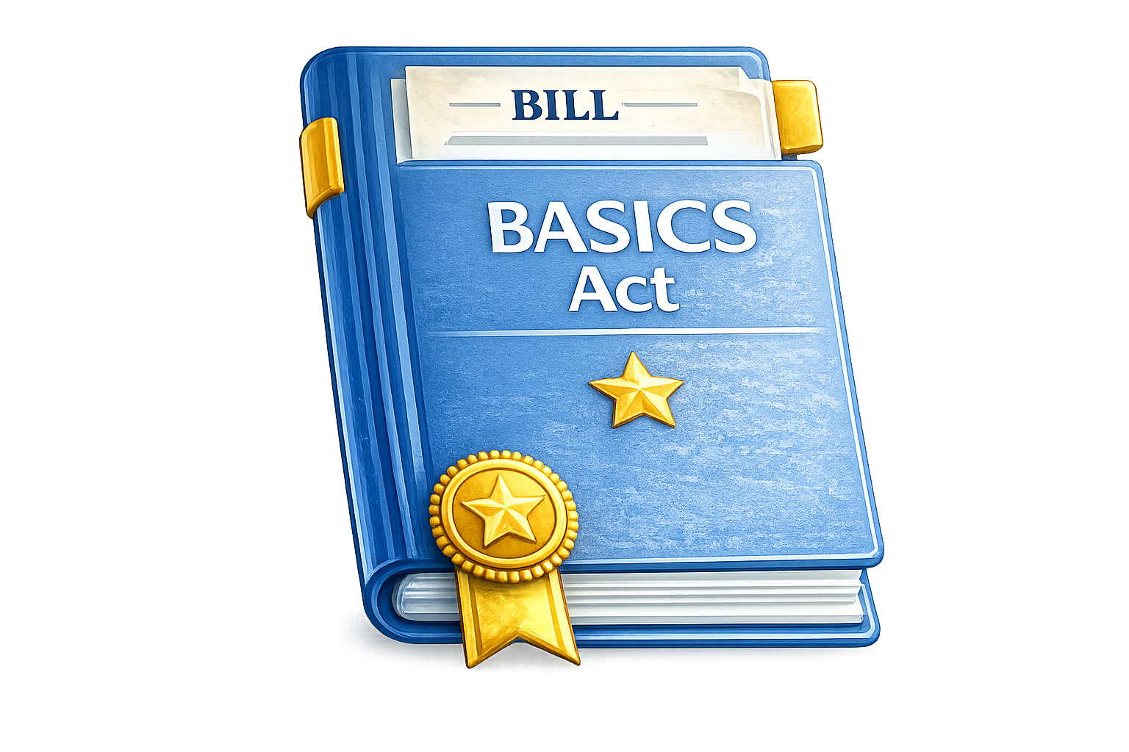
BASICS Act Provisions Reflected in BA250
Fixes bridges based on condition and ownership
↳ New bridge program with competitive set-aside for locals in BA250
Delivers local and regional priority projects faster
↳ Streamlining, categorical exclusions & project delivery reforms in BA250
Targets safety dollars to high-risk roads
↳ Local safety competitive SS4A program in BA250
Strengthens accountability and local project selection
↳ More consultation requirements for states, locals, MPOs & RTPOs in BA250
Builds planning capacity to deliver better projects faster
↳ Improvements to metropolitan planning program in BA250
Protects local and regional dollars from transfer
↳ Certain programs require state consultation before transfer in BA250
Notes:
APPENDIX SECTION
Feel free to use the follow slides for more of a deep dive into the bill – remember to “unhide” the slides before use.

Slide 18
BASICS Act – Where LOT Coalition Work Remains
RTPO funding was dropped from BA250
What the BASICS Act RTPO Proposal would do
$150M
$300K
100%
per year, FY27–31
rural & nonmetropolitan planning
minimum per year
for each designated RTPO
federal share
— fully federally funded
Provides financial support for existing RTPOs and creates a pathway for regions and states that do not yet have formally designated RTPOs
Notes:
APPENDIX SECTION
Feel free to use the follow slides for more of a deep dive into the bill – remember to “unhide” the slides before use.

Slide 19
Local Formula Programs
Local Formula Funding Increases
Excludes $3.75B SS4A and $12B STAG programs
+$3.7B
FY26 to FY27 increase
+$14.7B
IIJA → BUILD 250 (+30.1%)
$48.97B
IIJA formula funds
$63.70B
BUILD 250 formula funds
→
BUILD 250 is a 4% overall Contract Authority increase from IIJA — but local formula dollars grow nearly 7.5× that amount
Bridge Program
$9B
per year
25%
local set-aside for in-state competition
New dedicated bridge funds
Locals compete for a guaranteed in-state slice.
Notes:
APPENDIX SECTION
Feel free to use the follow slides for more of a deep dive into the bill – remember to “unhide” the slides before use.

Slide 20
Local Formula Program - Capital
STBG / TAP
CMAQ
+$1.25B
FY26 → FY27
+7.59%
+$12.1B
IIJA → BUILD 250
+13.28%
+$144M
FY26 → FY27
+5.26%
+$1.82B
IIJA → BUILD 250
+13.79%
★ Most growth of any capital-focused formula program
Descending set-aside from 10% for alt-fuel charging (FY27)
⚠ Note: CMAQ growth does not fully replace the eliminated NEVI / Carbon Reduction programs
Notes:
APPENDIX SECTION
Feel free to use the follow slides for more of a deep dive into the bill – remember to “unhide” the slides before use.

Slide 21
Local Formula Programs - Transit
Urbanized Area Formula (Sec. 5307)
Bus/Bus Facility Formula (Sec. 5339(a))
+10%
FY2026 → FY2027
$400M/yr
All Stations Accessibility
Program set-aside
2×+
More than doubles
over 5 years
Lo-No
Program eliminated
Funds flow into 5339(a)
All Stations Accessibility Program is a $400M/year takedown of Sec. 5307 apportionment
Growth directly tied to elimination of the Lo-No program
BUILD America 250 boosts both urbanized transit formula funding and bus capital funding
Notes:
APPENDIX SECTION
Feel free to use the follow slides for more of a deep dive into the bill – remember to “unhide” the slides before use.

Slide 22
Other Helpful MPO Provisions
TIP/STIP Amendments
MPO Eligibility – INFRA
MPO Eligibility – Bridge
Sec. 1113
Sec. 1105
Sec. 1108
Unchanged projects from past TIP/STIP can be re-added by amendment. No new public review required.
MPOs serving urbanized areas of 50k+ can now apply.
TMA MPOs are eligible for the competitive program, plus a consultation role on the 20% off-system set-aside.
Jason’s Law
Olympics & FIFA Assistance
Sec. 1127
Sec. 7104
MPOs are eligible for the CMV truck-parking competitive grant program.
Transportation assistance for major events. MPOs in covered areas eligible.
Notes:
APPENDIX SECTION
Feel free to use the follow slides for more of a deep dive into the bill – remember to “unhide” the slides before use.

Slide 23

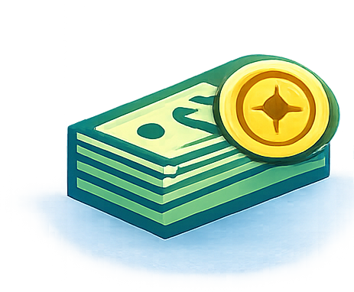
GAO Reports – Local & Regional Focus
Review of State and Local Consultation Processes
Study on Effectiveness of Formula Programs
Study on Effectiveness of Discretionary Grants
Recommends ways to improve consultation and communication among states, MPOs, and RTPOs.
Assesses how DOTs distribute formula funds to local and regional governments, select projects, and align funding with performance goals.
Targets ways to improve project selection, reduce cost overruns, and strengthen the efficiency and administration of USDOT competitive grants.
Bottom line: All studies require GAO to report to Congress within 2 years — sharpening how USDOT consults, distributes formula funds, and awards discretionary grants to states, MPOs, and RTPOs.
Notes:
APPENDIX SECTION
Feel free to use the follow slides for more of a deep dive into the bill – remember to “unhide” the slides before use.

Slide 24
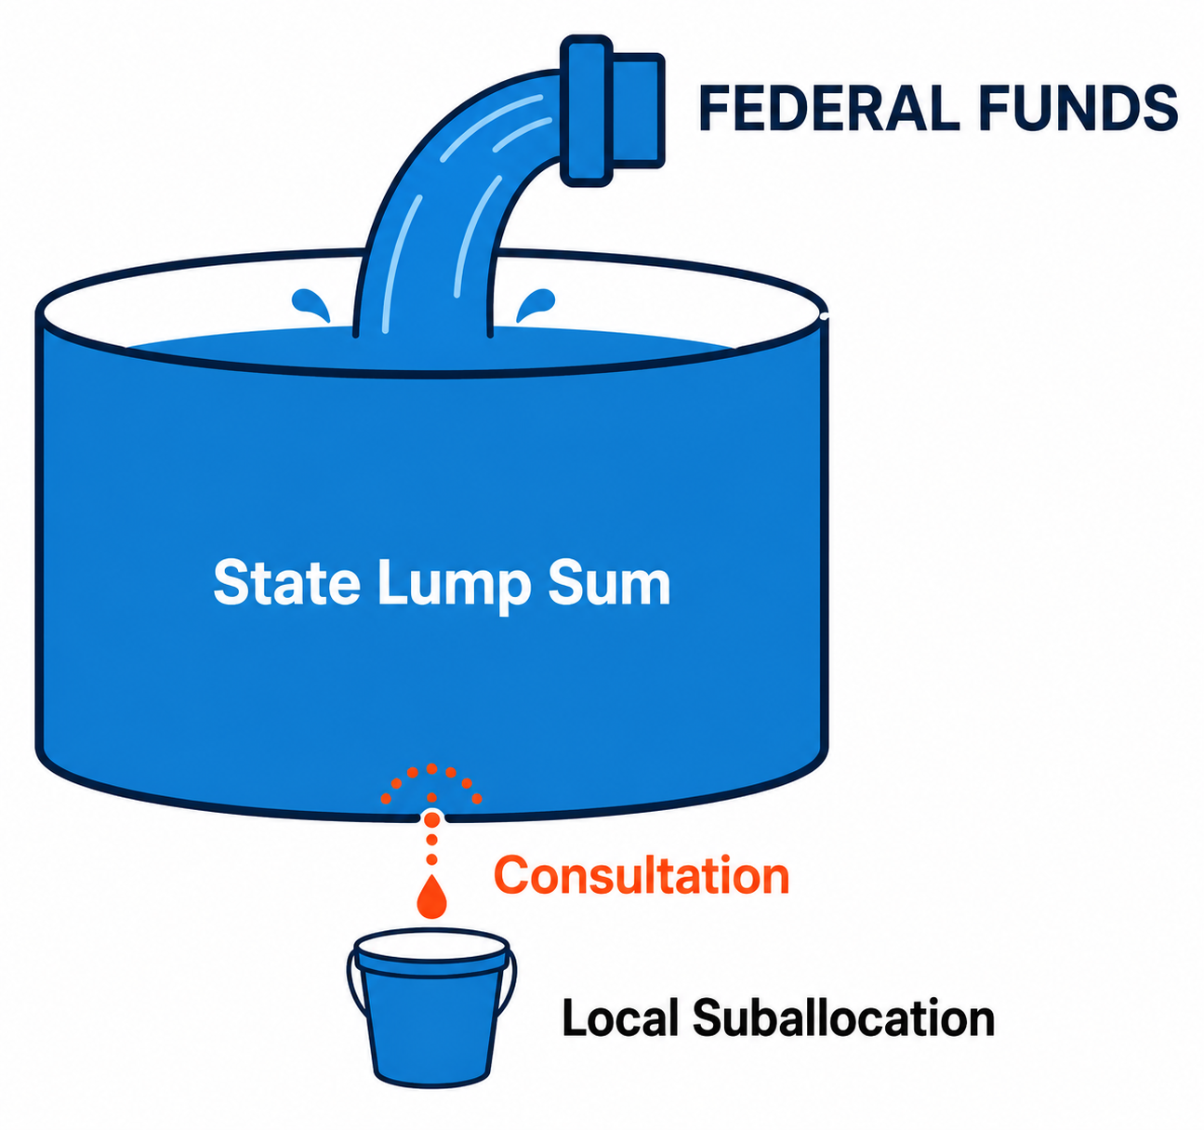
What AMPO is Monitoring
⚠ Consolidated Funding Pilot Program
Beginning FY28, up to 10 states receive their base highway apportionment as a single lump-sum block grant instead of separate formula silos.
  Must obligate 25% to regional and local areas, proportional to urbanized-area population (STBG-style).
  States to “consult” with MPOs & RTPOs on distributing local funds.
⚠ Consolidated Transit Block Grant Program
Opt-in: a pilot state applies, and impacted recipients each choose whether to participate.
  Funding: Sec. 5310, 5311(c)(5), 5336, 5337, and 5339(a).
  “Primary Urbanized Areas” (population over 3.5M, or over 200,000 and crossing state lines) can opt out in states that consolidate.
The Risk
Notes:
APPENDIX SECTION
Feel free to use the follow slides for more of a deep dive into the bill – remember to “unhide” the slides before use.

Slide 25
What AMPO is Monitoring
⚠ CRP Eliminated (Sec. 1125)
Beginning FY 2027, states and MPOs lose their dedicated CRP allocation. There is no one-for-one replacement, but most CRP-funded projects stay eligible under other federal programs:
  STBG — likely where CRP dollars shift (flexible).
    Bill also expands STBG eligibility for resilience to natural disasters and severe weather.
  CMAQ — continues to fund congestion-reduction and air-quality projects.
  Transportation Alternatives — funding remains for active-transportation projects.
⚠ CMAQ (Sec. 1118)
Funding rises ~5.3% from $2.75B (FY26) to $2.89B (FY27), climbing gradually to a ~$15.02B five-year total. Eligibility broadened for digital infrastructure and congestion-management tech.
Alternative Fueling Projects: a minimum CMAQ share must be set aside (spent anywhere in-state).
  Could reduce funds available for regional/local priorities.
  Likely a stand-in for the eliminated NEVI program.
Minimum CMAQ Share for Alternative Fueling (in-state)
Fiscal Year | Min. Share AFP
FY 2027 | 10%
FY 2028 | 9%
FY 2029 | 8%
FY 2030 | 7%
Notes:
APPENDIX SECTION
Feel free to use the follow slides for more of a deep dive into the bill – remember to “unhide” the slides before use.

Slide 26
OVERVIEW OF BA250
Funding Overview
Authorizations, FHWA, FTA, FRA, OST, and More
AMPO.ORG
Notes:
APPENDIX SECTION
Feel free to use the follow slides for more of a deep dive into the bill – remember to “unhide” the slides before use.

Slide 27
Total 5-Year Authorization
$580,972,000,000
Sec. 1101–1319 · Highway Trust Fund & General Fund Authorization
FY 2026 — FY 2031
Notes:
APPENDIX SECTION
Feel free to use the follow slides for more of a deep dive into the bill – remember to “unhide” the slides before use.

Slide 28
Federal-Aid Highway Formula Programs | Sec. 1101(a)(1) | FY 2026–2031
Program Name | Source | FY 2026 (IIJA) | FY 2027 | FY 2028 | FY 2029 | FY 2030 | FY 2031 | 5-Year Total
Federal-Aid Highway Program | HTF-HA CA | $56.8B | $56.9B | $57.5B | $58.7B | $59.8B | $60.9B | $293.9B
↳ NHPP | HTF-HA CA | $30.8B | $32.2B | $32.5B | $33.2B | $33.8B | $34.4B | $166.0B
↳ STBG | HTF-HA CA | $15.0B | $16.1B | $16.3B | $16.6B | $16.9B | $17.2B | $83.0B
↳ TA (Transportation Alternatives) | HTF-HA CA | $1.5B | $1.6B | $1.6B | $1.7B | $1.7B | $1.7B | $8.3B
↳ HSIP | HTF-HA CA | $3.2B | $3.4B | $3.4B | $3.5B | $3.6B | $3.6B | $17.5B
↳ Rail Highway Grade Crossing | HTF-HA CA | $245M | $250M | $250M | $250M | $250M | $250M | $1.3B
↳ CMAQ | HTF-HA CA | $2.7B | $2.9B | $2.9B | $3.0B | $3.1B | $3.1B | $15.0B
↳ Planning (PL) | HTF-HA CA | $474M | $520M | $540M | $560M | $580M | $600M | $2.8B
↳ NHFP | HTF-HA CA | $1.5B | $1.6B | $1.6B | $1.6B | $1.7B | $1.8B | $8.3B
↳ SAFETEA-LU Set Aside | HTF-HA CA | $4M | $4M | $4M | $4M | $4M | $4M | $18M
↳ CRP (IIJA, FY26 only) | HTF-HA CA | $1.3B | — | — | — | — | — | —
↳ PROTECT Formula (IIJA, FY26 only) | HTF-HA CA | $1.5B | — | — | — | — | — | —
Notes:
APPENDIX SECTION
Feel free to use the follow slides for more of a deep dive into the bill – remember to “unhide” the slides before use.

Slide 29
Bridge & Discretionary Grant Programs | Sec. 1101 | FY 2026–2031
Section | Program Name | Source | FY 2026 (IIJA) | FY 2027 | FY 2028 | FY 2029 | FY 2030 | FY 2031 | 5-Year Total
1101(a)(2) | TIFIA Credit Subsidies | HTF-HA CA | $250M | $250M | $250M | $250M | $250M | $250M | $1.3B
1101(a)(3) | Bridge Program | HTF-HA CA | $700M | $9.2B | $9.2B | $9.2B | $9.2B | $9.2B | $46.0B
1101(a)(4)(A) | Tribal Transportation Program | HTF-HA CA | $628M | $643M | $657M | $671M | $686M | $701M | $3.4B
1101(a)(4)(B) | Federal Lands Transportation Program | HTF-HA CA | $456M | $464M | $472M | $480M | $488M | $496M | $2.4B
 | ↳ National Park Service | HTF-HA CA | $360M | $365M | $371M | $376M | $382M | $388M | $1.9B
 | ↳ U.S. Fish & Wildlife Service | HTF-HA CA | $36M | $42M | $42M | $42M | $42M | $42M | $210M
 | ↳ U.S. Forest Service | HTF-HA CA | $28M | $30M | $31M | $33M | $34M | $36M | $163M
1101(a)(3)(C) | Federal Lands Access Program | HTF-HA CA | $309M | $314M | $320M | $326M | $332M | $338M | $1.6B
1101(a)(5) | Territorial & Puerto Rico Hwy. Program | HTF-HA CA | $237M | $242M | $247M | $253M | $258M | $263M | $1.3B
1101(b)(1)(A) | SS4A (Safe Streets & Roads for All) | HTF-HA CA | — | $500M | $625M | $750M | $875M | $1.0B | $3.8B
1101(b)(1)(B) | Surface Transportation Accelerator | HTF-HA CA | — | $2.4B | $2.4B | $2.4B | $2.4B | $2.4B | $12.0B
1101(b)(1)(C) | PROTECT Grants | HTF-HA CA | $300M | $500M | $500M | $500M | $500M | $500M | $2.5B
1101(b)(1)(D) | Nat. Signif. Federal Lands & Tribal | HTF-HA CA | $55M | $55M | $55M | $55M | $55M | $55M | $275M
1101(b)(2)(A) | INFRA Grants | GF Auth. | $1.4B | $1.2B | $1.2B | $1.2B | $1.2B | $1.2B | $6.0B
1101(b)(2)(B) | Bridge Completion Program | HTF-HA CA | $700M | $2.0B | $2.0B | $2.0B | $2.0B | $2.0B | $10.0B
Notes:
APPENDIX SECTION
Feel free to use the follow slides for more of a deep dive into the bill – remember to “unhide” the slides before use.

Slide 30
Research, Technology & Other Programs | FY 2026–2031
Section | Program Name | Fund Source | FY 2026 (IIJA) | FY 2027 | FY 2028 | FY 2029 | FY 2030 | FY 2031 | 5-Year Total
1101(a)(1)(A) | Highway Research R&D Program | HTF-HA CA | $147M | $150M | $153M | $156M | $159M | $162M | $780M
1101(a)(1)(B) | Tech. & Innovation Deployment Program | HTF-HA CA | $110M | $112M | $114M | $117M | $119M | $121M | $584M
1101(a)(1)(C) | Training & Education | HTF-HA CA | $26M | $27M | $27M | $28M | $28M | $29M | $138M
1101(a)(1)(D) | Intelligent Transportation Systems | HTF-HA CA | $110M | $112M | $114M | $117M | $119M | $121M | $584M
1101(a)(1)(E) | University Transportation Centers | HTF-HA CA | $82M | $84M | $85M | $87M | $89M | $91M | $435M
1101(a)(1)(F) | Bureau of Transportation Statistics | HTF-HA CA | $27M | $27M | $28M | $28M | $28M | $28M | $139M
1101(d)(1) | Wildlife Crossings Pilot Program | HTF-HA CA | $80M | $80M | $80M | $80M | $80M | $80M | $400M
1101(d)(2) | Truck Parking Pilot | HTF-HA CA | — | $150M | $150M | $150M | $150M | $150M | $750M
1104(1) | FHWA Administrative Expenses | HTF-HA CA | $531M | $478M | $488M | $498M | $508M | $519M | $2.5B
1116 | Ferry Boats and Terminal Facilities | HTF-HA CA | $118M | $182M | $184M | $186M | $189M | $191M | $932M
1129(b)(2) | Registration Fee Implementation | GF Auth. | — | $104M | — | — | — | — | $104M
1136 | Tribal High Priority Projects Program | GF Auth. | $30M | $30M | $30M | $30M | $30M | $30M | $150M
1319 | Stopping Threats on Pedestrians (STOP) | GF Auth. | $5M | $5M | $5M | $5M | $5M | $5M | $25M
Notes:
APPENDIX SECTION
Feel free to use the follow slides for more of a deep dive into the bill – remember to “unhide” the slides before use.

Slide 31
OVERVIEW OF BA250
Modal Summary
Active Transportation, Transit, Passenger Rail, and Project Delivery
AMPO.ORG
Notes:
APPENDIX SECTION
Feel free to use the follow slides for more of a deep dive into the bill – remember to “unhide” the slides before use.

Slide 32
Active Transportation
Transportation Alternatives (TAP)
Recreational Trails Program (RTP)
$1.6B/year — largest dedicated federal active transportation source
⚠ Easier for states to transfer TAP funds away from bike/ped uses
$84M/year — stable, no significant increase
✓ E-bikes now allowed on non-motorized RTP trails
ATIIP — Eliminated
Micromobility & E-Bike Safety
✕ Program repealed
The Active Transportation Infrastructure Investment Program is eliminated under BA250
Federal study on micromobility safety and children
⚠ Does not address high-speed e-motor devices
Project Delivery & Permitting
Vehicle & Battery Safety
USDOT directed to clarify when bike/ped infrastructure projects qualify for accelerated environmental review
Advances crash avoidance tech to improve detection of cyclists & pedestrians. Lithium-ion battery safety standards for e-bikes & micromobility.
Notes:
APPENDIX SECTION
Feel free to use the follow slides for more of a deep dive into the bill – remember to “unhide” the slides before use.

Slide 33
Transit Overview
$87.6 Billion over 5 years | ⚠ Decrease from IIJA levels | Significant structural changes
Consolidated Transit Block Grant
Urbanized Area Formula — Sec. 5307
States may consolidate 6 FTA formula programs into a single lump-sum grant
✓ Primary UZAs (3.5M+ or multi-state 200K+) excluded — retain direct FTA relationship
MPOs in participating UZAs must be consulted
Expands operating assistance eligibility to systems operating 101–125 buses at peak
Replaces public hearing requirement with publish-and-comment process
Mandatory 1% floors for security and ADA accessibility
Capital Investment Grants (CIG)
MPO Planning & Transit Oriented Development
"Small Starts" renamed "Streamlined Starts" — eligibility raised to projects under $1 billion
Improved economic development ratings to incentivize transit-oriented housing
Program streamlined overall for faster project delivery
Transit planning changes mirror highway title — maintains consistency across modal planning
TOD Planning Program made permanent and expanded to new fixed guideway and core capacity projects
Notes:
APPENDIX SECTION
Feel free to use the follow slides for more of a deep dive into the bill – remember to “unhide” the slides before use.

Slide 34
Passenger Rail Overview
Rail Funding Structure
⚠ No advance appropriations guarantee
Shifts from advance appropriations (IIJA) to annual appropriations
Historical funding ~$3B/yr — far below the ~$13B/yr needed to fully deliver on authorized levels.
$63.9B
5-Year Authorization
~$3B/yr
Historical Appropriation
~$13B/yr
Needed to Fully Fund
NIPR Program
$18.5B Competitive Grants
National Intercity Passenger Rail Partnership.
Expanded to non-Amtrak operators and interstate rail compacts.
Prioritizes financial sustainability.
CRISI Program
$9.1B Safety & Infrastructure
Consolidated Rail Infrastructure & Safety Improvements.
Expanded eligibility: freight congestion, intercity expansion, safety tech.
Railroad Crossing Safety
$3.65B Grade Crossing Elimination
Expanded to rail-safety nonprofits. Advanced technology and data-driven safety improvements.
Reduces mandatory transfer requirements.
Amtrak Governance
New accountability rules: FOIA-style compliance, open board meetings, executive pay disclosure, OIG oversight.
Equipment Pools
Interstate compacts may form shared equipment pools for procurement, leasing, and fleet management via RRIF loans.
Route Studies
USDOT directed to study new corridors in Midwest, Texas, California, and Northeast.
Emergency Relief
New disaster recovery program.
Up to 80% federal cost share for states, agencies, and operators.
Notes:
APPENDIX SECTION
Feel free to use the follow slides for more of a deep dive into the bill – remember to “unhide” the slides before use.

Slide 35
Permitting and Project Readiness Overview
NEPA Streamlining & Permitting Reforms | Accelerated delivery across all transportation modes
MPO Planning → EIS
Categorical Exclusions
Additional Reforms
Prior MPO planning analyses can now be used to eliminate alternatives from detailed consideration in an Environmental Impact Statement
★ Most significant MPO-specific benefit in the permitting title
Nearly Doubled
Federal share: $6M → $12M
Total cost: $35M → $70M
Secretary directed to reduce CE paperwork burden
Transit shelters in existing ROW automatically exempt
Transit CE Authority
UZAs over 200K may make CE determinations themselves
Streamlined Review Agreements
Expanded to all modes
Terms: 3 → 5 yrs (up to 10 yrs)
FTA Property Acquisition
May reimburse pre-review property acquisition if used for eligible project
Notes:
APPENDIX SECTION
Feel free to use the follow slides for more of a deep dive into the bill – remember to “unhide” the slides before use.

Slide 36


What’s Going on in the Senate?
SENATE POSITIONS
WHERE THE COMMITTEES STAND
Senate Democrats
Maintain multi-year investment levels set in IIJA (advanced appropriations letter)
EPW · No bill yet
Commerce · No bill yet
EPW Majority
Interested in a consolidated state pilot program — formula-driven, with state flexibility and control
Banking · No bill yet
The Senate will react to the House bill, but its final product may look very different on funding and policy
Bottom line: an extension seems likely
Notes:
APPENDIX SECTION
Feel free to use the follow slides for more of a deep dive into the bill – remember to “unhide” the slides before use.

